Slide 1
AI for Climate Action (SDG 13)
CO₂ Emissions Prediction System
Sebabatso & Team

Slide 2
Problem Statement
Climate change, driven by rising CO₂ emissions, presents a critical global challenge.
Accurate monitoring and prediction of CO₂ emissions are necessary for effective climate policies and actions.

Slide 3
UN SDG 13 - Climate Action
Take urgent action to combat climate change and its impacts.
This includes reducing greenhouse gas emissions, enhancing resilience to climate-related hazards, and integrating climate change measures into policies.

Slide 4
Project Objective
Build a supervised learning model to predict CO₂ emissions for different regions.
Use industrial activity, weather, energy usage, and traffic data to make accurate and actionable forecasts.

Slide 5
Dataset & Source
We use the Kaggle dataset: 'climate-change-dataset' by bhadramohit.
Python Import:
import kagglehub
path = kagglehub.dataset_download("bhadramohit/climate-change-dataset")
print("Path to dataset files:", path)

Slide 6
Machine Learning Approach
Model: Supervised Learning (e.g., Linear Regression, Random Forest, XGBoost)
Features: Year, Region, Energy Use, Temperature, Industry Activity
Target: CO₂ Emissions
Tools: Pandas, Scikit-learn, Matplotlib, Seaborn

Slide 7
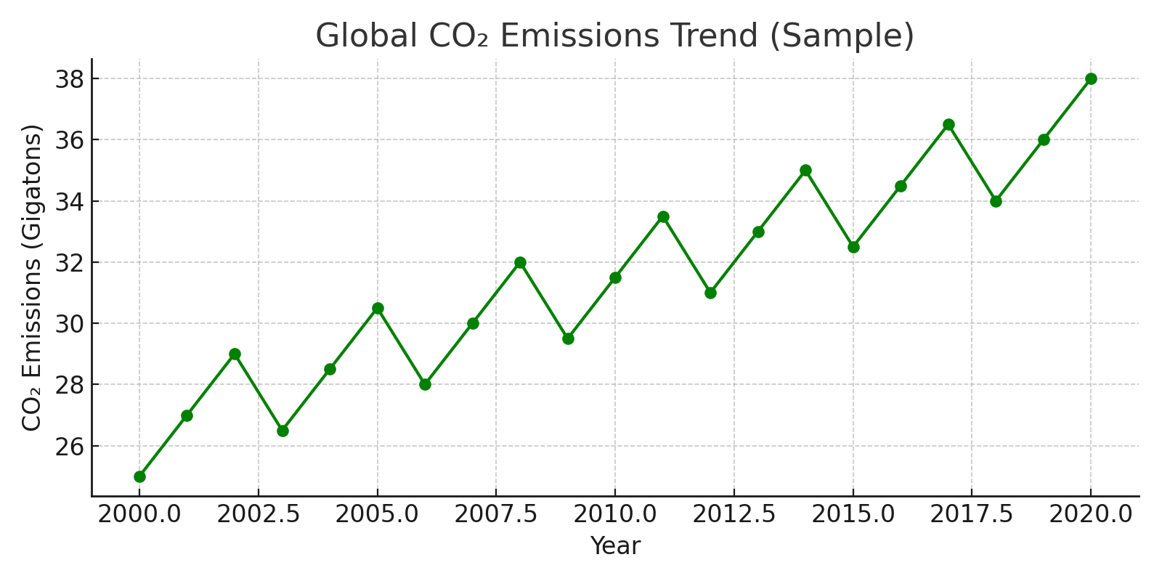
Model Performance & Visualization
Sample visualization showing a trend in predicted CO₂ emissions.

Slide 8
Additional ML Ideas for Climate Action
1. Wildfire Detection using CNNs
2. Renewable Energy Forecasting with LSTMs
3. Flood Risk Prediction
4. Smart Agriculture using Drones + ML
5. Sentiment Analysis on Climate Change
6. Reinforcement Learning for Energy Efficiency
7. Climate Modeling with Neural Networks

Slide 9
Team & Contributors
Group Members:
Sebabatso & Team
Course: AI for Sustainable Development (Week 2)
Platform: Kaggle, Google Colab, GitHub

Slide 10
Conclusion & Next Steps
✅ Accurate CO₂ prediction can inform better climate policies.
✅ Expand to real-time emissions monitoring.
✅ Integrate into a dashboard or mobile app.
Next Steps:
- Fine-tune models
- Include satellite data
- Publish results

